Slide 1
start

Slide 2
the
Dean of
Students
office
Notes:
My name is Mike – I work in the Dean of Students Office
Who is Same
Flip the Script on What Folks Think of the Dean of Students
If there is one thing that I can have you remember the Dean of Students is about Help. We are here to help.

Slide 5
There is
no one I trust
more

Slide 8
Notes:
And sex

Slide 9
Sexual Respect
No
Tolerance
Notes:
That is sexual respect and at the University of Akron that means…
Zero tolerance for gender based harassment, sexual assault, relationship violence or stalking

Slide 10
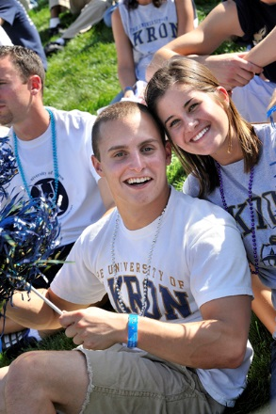
Notes:
But it also means that We are here to trust you… that this is your school… your community… and will follow the norms of the community that you create…
Sexual respect also means we all have a role to play in creating a safe environment.

Slide 11
Title IX

Slide 15
Sexual Assault
Domestic Violence
Dating Violence
Stalking
Battery
Indecent Exposure
Sexual Exploitation
SEXUAL
MISCONDUCT
Notes:
Sexual violence is an offense that is classified as forcible or non-forcible sex offense:
This includes …
Sometimes when I present this content folks ask why don’t I just say rape instead of sexual assault…
And I think they have a good point because we should be as clear as possible when talking about these behaviors but there is a catch and it is why I still use sexual assault…
When I talk about sexual assault I am talking about not just one form – rape… I am also talking about statutory assault, incest and fondling. Our students often don’t understand touching someone in their personal/private body is a form of sexual assault. We want to be clear about that because the consequences for a violation are steep.

Slide 16
Quid Pro Quo
Hostile Environment
SEXUAL
HARASSMENT
About Sex/Gender
Unwanted
Unreasonable Interference
Retaliation
Notes:
Sexual harassment is…
What is an example of sexual harassment

Slide 17
Notes:
Ok so we are working to stop and prevent sexual assault but what do we do when something happens…
We want students to be able to reach out for help…

Slide 18
Notes:
We know that they are likely going to be concerned about who they talk to and confidentiality is an important part to understand

Slide 19
Confidential Employee
Required To
Report
Counseling Center
Health Services
Faculty
RA
Coach
Organization Adviser
Dean of Students
Student Life
Academic Adviser
Graduate Assistant
Campus Partner
Rape Crisis Center
330-434-7273
Notes:
We have confidential employees… people who don’t tell others about what you share and are hear to listen and help…
Rape crisis center really aren’t our employees so we identify them as our campus partners…
If you work for the university and you are not a confidential employee… you are a responsible employee or just another way of saying required to report.
There are far more university employees required to report… students are generally not required – because you all are not employees… only RA’s and specific groups who have been deputized…

Slide 20
uakron.edu/title-ix

Slide 22
Options for Personal and Academic Support
Notes:
So why would someone want to report a sexual assault, stalking or dating violence…
First I would like to say is that more and more we have students reporting.. Because they trust the university and know we can offer tangible support. Last year over 100 reports of sexual harassment, sexual violence came through the Dean of Students office.
But why would someone want to report. Typically two reasons or two paths…
They need or want support – help – assistance
They want investigations and accountability
Most important to know students can get help even if they don’t want to pursue criminal charges or disciplinary action. They two are not tied together.

Slide 23
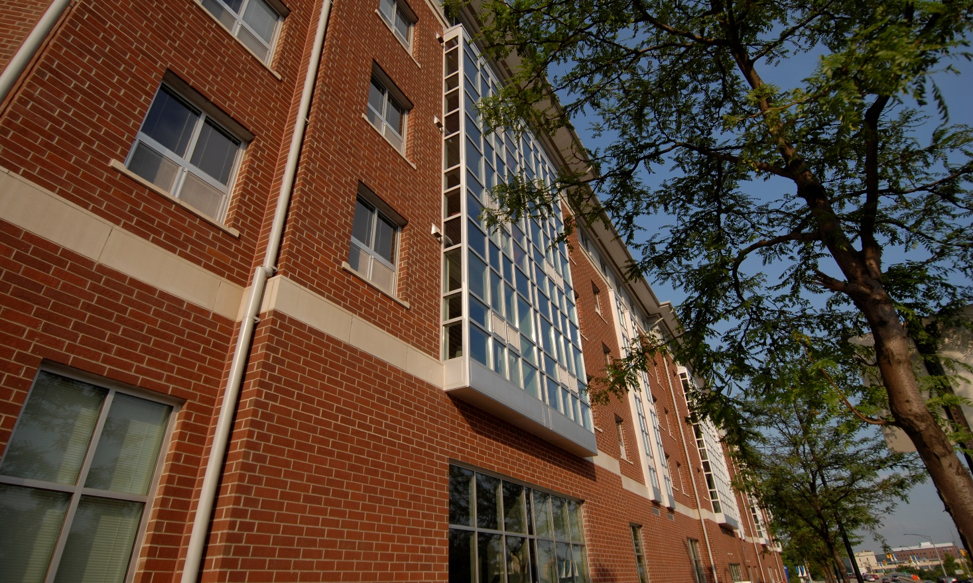
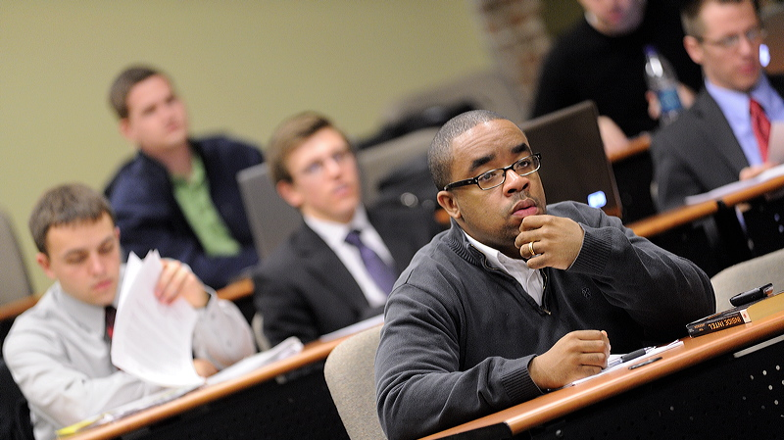
Notes:
By enacting immediate interim measures and ongoing remedial measures of support the Title IX Coordinator will:
Provide information about available medical and mental health care
Offer personalized and tailored support that is reasonably available and which may include:
Providing No-Contact-Directives prohibiting any contact or communication
Separating the victim from the alleged perpetrator in class settings or in campus housing facilities
Providing academic counseling and support including tutoring and assistance in arranging absence from class

Slide 24
Options for Investigations and Accountability

Slide 25
Notes:
The Title IX Deputy coordinator will also
Assist in notifying UAPD of criminal activity
Seek the victim’s consent to investigate:
The University may not be able to investigate without the victim’s consent
The Coordinator will consider requests for confidentiality if an investigation is necessary
Discuss which University departments may investigate and how the investigations are conducted
Determine if any immediate action is necessary to ensure the community is safe.

Slide 26
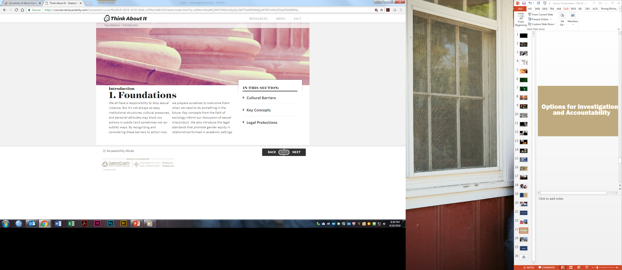

Slide 27
Questions
Contact:
Mike Strong
Dean of Students
& Title IX Coordinator for Students
mstrong@uakron.edu
330.972.6048

